Slide 1
BFX AT-100 FHD channel (live) noise FA report
Prepare by: PE – JUSTIN
Date: 2025/07/17

Slide 2
Problem Description
Issue Description (5W2H)
When | 2025-May-24
Who | SH Son
Where | ALT customer side, Location : SK networks warehouse, Anseong, Korea.
What | ALT customer return 1pc BFX-AT 100 have video FHD (1920 x 1080, codecs: H264 AVC/AAC) channel live suffers from image noise
Why | TBD
How | NG product have video FHD channel (live) image noise: S/N range: 2149688001202503069476
How much | 1pcs / 60.000 pcs ~ 0.00166% (Qty inspection lot 60k delivered on 2025.4)

Slide 3


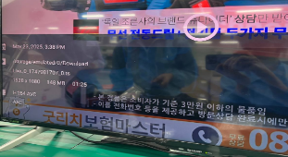
Confirm Fail Symptom
Double check fail symptom:
Use product have customer account to play “Live_0_1747981707_0.ts” video in app “MX player” ➔ FHD (1920 x 1080, codecs: H264 AVC/AAC) channel live suffers from image noise
FHD channel (live) image noise
FHD channel (live) image OK
Summary:
NG product play video FHD channel (live) (1920 x 1080, H264 AVC/AAC) suffers from image noise

Slide 4
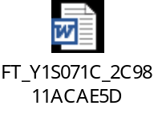
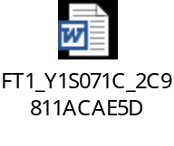
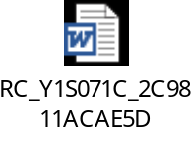
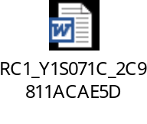
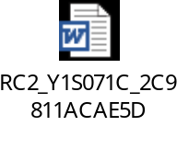
Production History Data Checking
T Level data (SMT)
SN | Test Station
Y1S071C | SMT LOADING | INSP-OUTSIDE | PCB_STOCKIN
 | 2025-03-14 16:25:11 | 2025-03-17 20:44:18 | 2025-03-17 22:02:13
Dot Level data (FATP )
S/N range | Test Station
2149688001202503069476 | UK | FT | FT1 | RC | RC1 | RC2
 | 3/22/2025 11:26 | 3/22/2025 11:34 | 3/22/2025 11:42 | 3/22/2025 12:02 | 3/22/2025 12:20 | 3/22/2025 13:17
Test logs | UK test haven’t logs test
Summary:
- This unit has PASSED normally SMT and FATP.
- Shipping date: 2025/03/26 2:45AM

Slide 5













Visual Inspection And X-ray Checking
VI checking:
SIZE | IMAGE | RESULT
TOP |  | NORMAL
BOT |  | WARRANTY SEAL BROKE
PART |  | NORMAL
X-ray checking:
S/N | U503 | U504 | U505 | U506 | U602 | U1 | U1101 | FIL1401 | FIL1402
Y1S071C
Summary:
VI found product warranty seal broken => housing has been opened from the ALT customer side.
- X-ray: No found abnormal

Slide 6
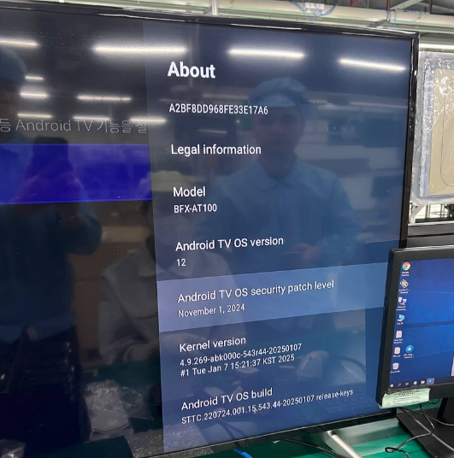
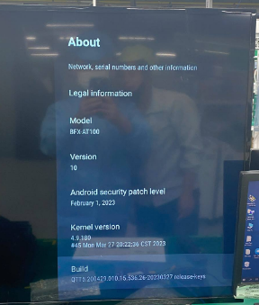
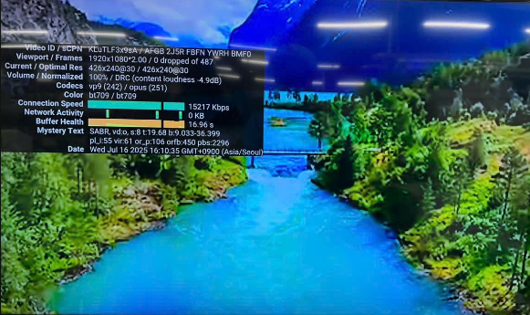
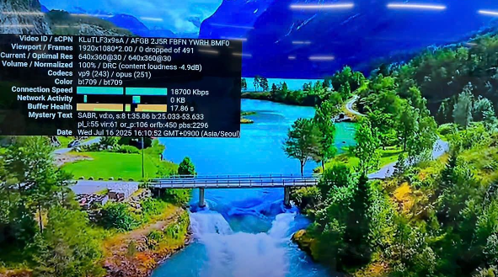
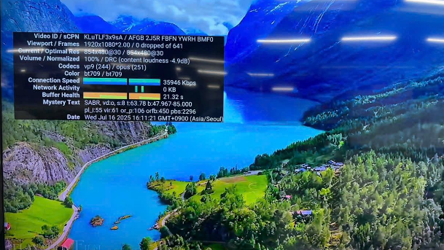
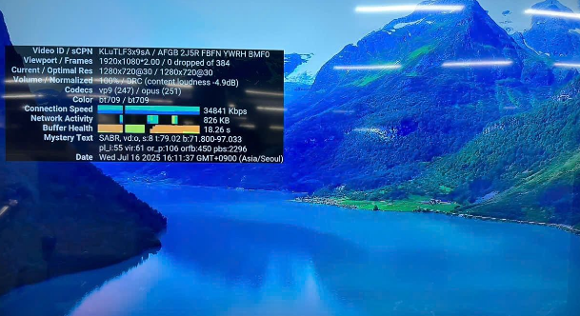
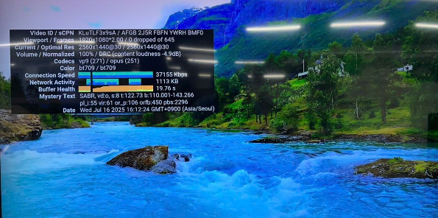
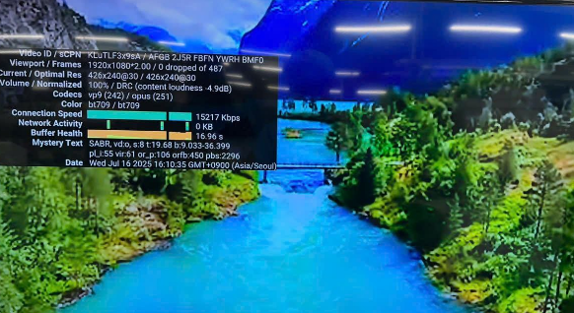
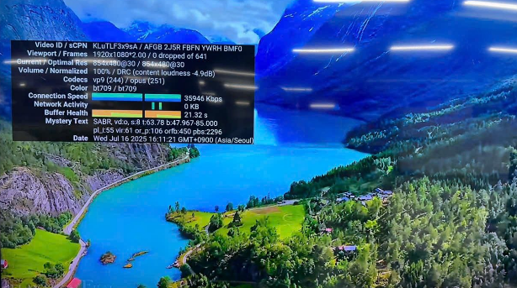
Re-test Analysis
Re-test at OBA station:
- Can’t re-test at OBA because the product had login customer account and update version (Android ver12)
- Product use the factory software can test at OBA station (Android ver 10)
Check function play YOUTUBE video at OBA station: Result is Normal
240p (426x240 30fps/codecs VP9)
360p (640x360 30fps/codecs VP9
480p (854x480 30fps/codecs VP9
720p (1280x720 30 fps/codecs VP9)
Summary:
Product can’t re-test at OBA Because we do not have an account to log into the customer interface, we cannot open the MX player App. ( 구글설정 -> MX player -> Downloads -> open “Live_0_1747981707_0.ts” )
Check video YOUTUBE: no found abnormal.
Video QHD (2560x1440 30 fps/codecs VP9)
Video FHD (1920x1080 30fps/codecs VP9)
Video UHD (3840x2160 30fps/codecs VP9)

Slide 7
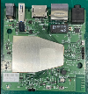
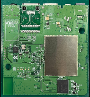
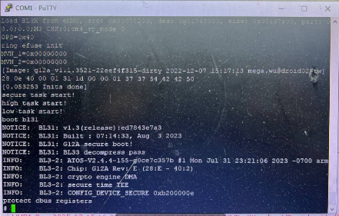
Console Log Analysis
Open housing + VI and check console log :
Open housing + VI
Check console log
NORMAL
TOP
BOT
- “Protect cbus registers” is enabled on the product ➔ Can’t backing up the factory software to verify other case
- To restore the factory software, it would be necessary to replace the BGA + eMMC. However, doing so would remove the current failure state, making further failure analysis impossible
Summary:
- Product can’t back up the factory software

Slide 8
Coverage checking
Re-check all items test at FAC
T99X171.00 TEST FLOW
A
SMT
UK
FT
FT1
FT3 (5%)
B
Auto copy flash by burning Tool
Adb Connect DUT
Check Firmware Version
LED Test
Check LED Isolation
Write Serial Number
Check Soc SecureBoot
Check Memory
Check Usb Storage
Check resolution 2160p60Hz
Check HDMI video noise
Check VP9 video on TV
Check 4K video on TV
Check Video Res 3840X2160
Check Video Fps 0x3c
Check USB3.0 Link Speed
Unmount USB
Check Firmware Version
Push file key
Write MAC & Bluetooth MAC
Check OTT Key
Write Keys
Test TX, RX throughput
Check LED
Test Remote IR
Check USB2.0 LinkSpeed
Check Audio 4K
Check Audio Record
Check HDMI HEVC HDR10+ Video
Check HDMI VP9 Video
Check HDMI H265 Video
Check Screen Shake
Check scan BT
Unmount USB
Check Device Alive
Login DUT
LED Test
Check Firmware Version
Read DUT Info
Check Burnin
Check CPU Temperature
Test Remote IR
Check Usb Storage
Check res 2160p30Hz
Check scan BT
Check Audio 4K
Check HDMI VP9 Video
Check HDMI H265 Video
Set Burnin off
B
RC
RC1
OBA
RC2
FG
C
Check Firmware Version
Read DUT Info
Check HDCP Checksum
Download Apk Remote file
Adb Connect DUT
Test Channel BT-Up
Test Channel BT-Down
Reset Relay
Check button
Check Bluetooth RSSI
Download Customer FW from USB
Unmount USB
Check Barcode.txt File
Read Data QR Code
Save keys to database
Check Product Bootup
Check SN, MAC ETH, Version, build
Check USB 3.0
4K Youtube Inspection
Check Voice
Bluetooth function Inspection
Reset Setting inspection
Check Result.txt File
Read Data QR Code
Check SN from database
Check Data LINK
Summary:
- FATP doesn’t test file “Live_0_1747981707_0.ts” (Video FHD 1920 x 1080, codecs: H264 AVC/AAC)

Slide 9
Summary
No.# | Items | Result
1 | Confirm Fail Symptom | - FHD (1920 x 1080, codecs: H264 AVC/AAC) channel live suffers from image noise
2 | Production history | - No abnormal
3 | Visual Inspection And X-ray Checking | - VI found product warranty seal broken => housing has been opened from the ALT customer side - X-ray no found abnormal
4 | OBA Function Analysis | - Product can’t re-test at OBA station - Check video YOUTOBE: no found abnormal
5 | Check Console Log | - Product can’t back up the factory software
6 | Coverage | - FATP doesn’t test file “Live_0_1747981707_0.ts” (Video FHD 1920 x 1080, codecs: H264 AVC/AAC)
*NEXT FA:
- Co-work with the RD team to define the next analysis steps or alternative analysis methods. Owner: RD, PE Justin. Due date: 07/22
- Co-work with the PQE department to contact the customer and request support in disabling the protection mode, in order to proceed with further technical actions. Owner: PQE Rachel. Due date: 07/25

